Slide 1


L-40 DataLab
Vincenzo Miracula
Universidad Complutense de Madrid
Università of Catania

Slide 2
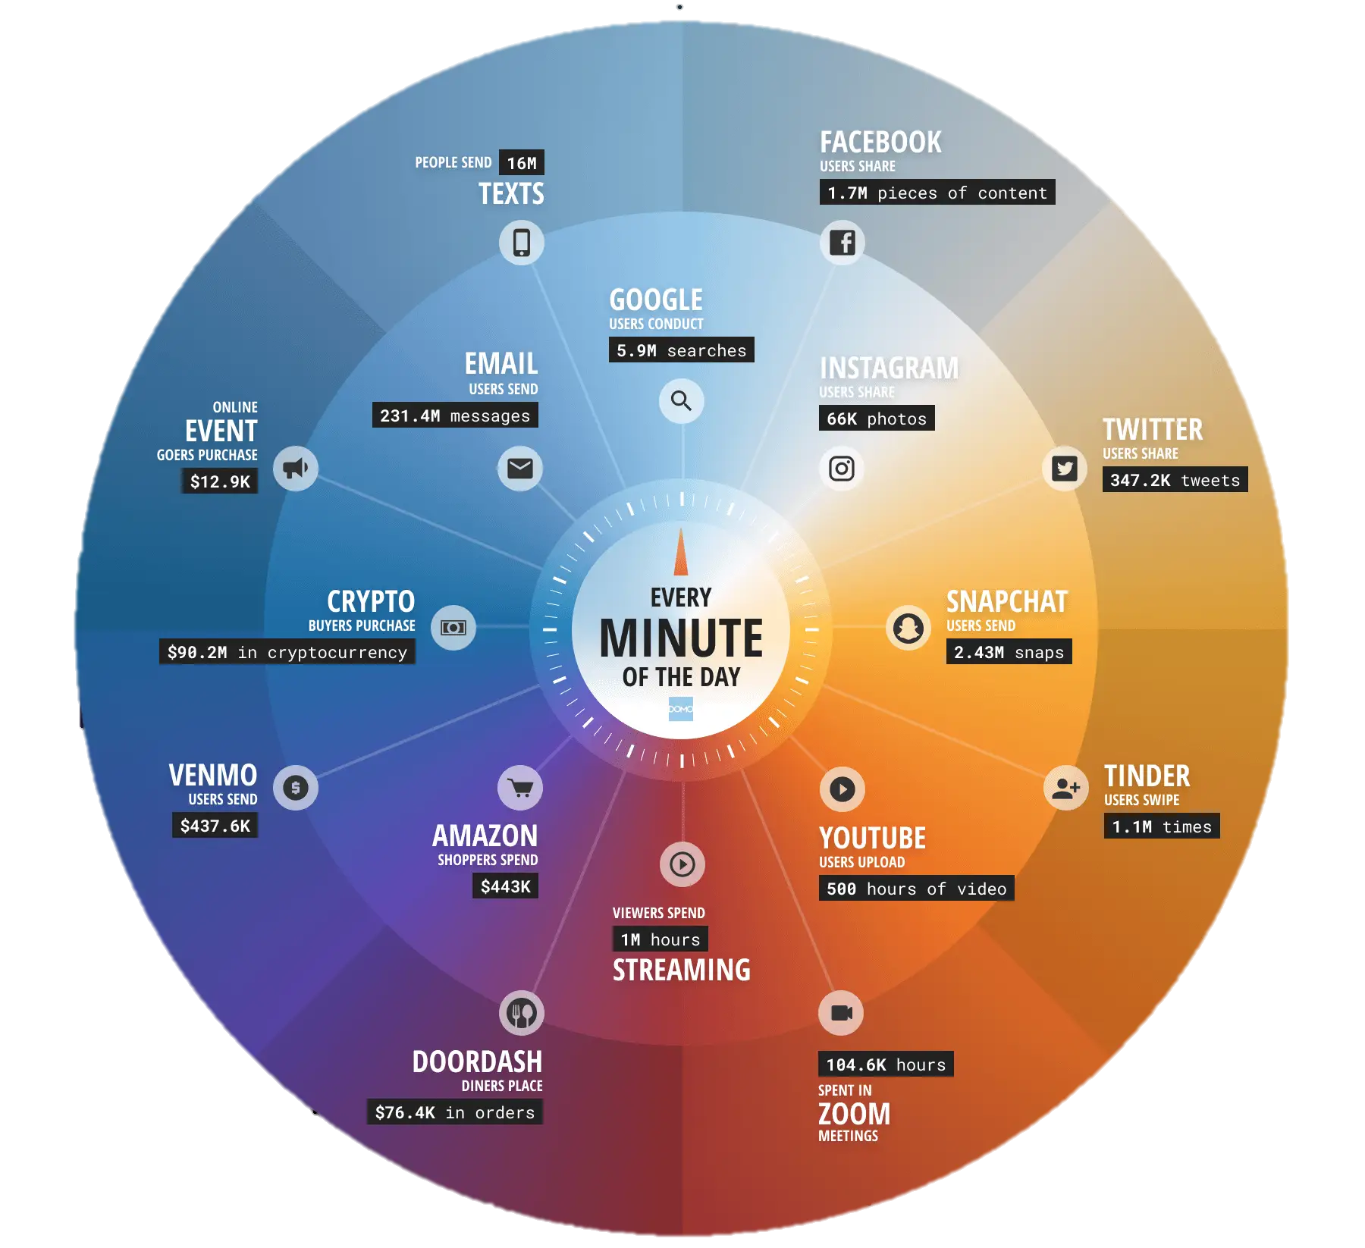
What happens in a minute on the internet?
Facebook
1.7 million of content
X (twitter)
347,2K tweets
Youtube
500 hours of video viewed
Google
5.9 million searches

Slide 3
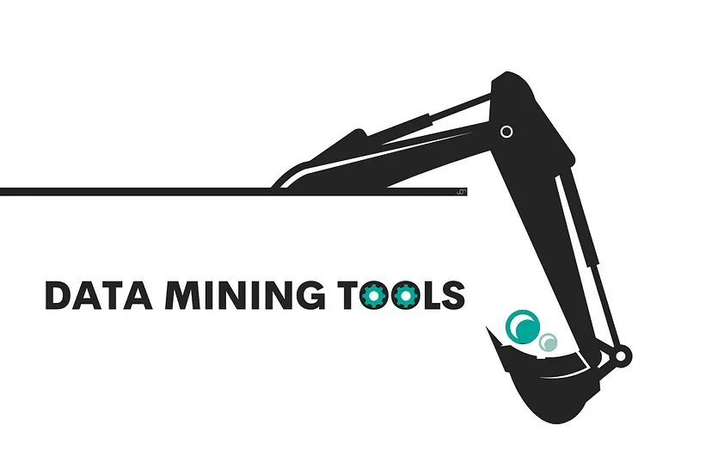

Slide 4
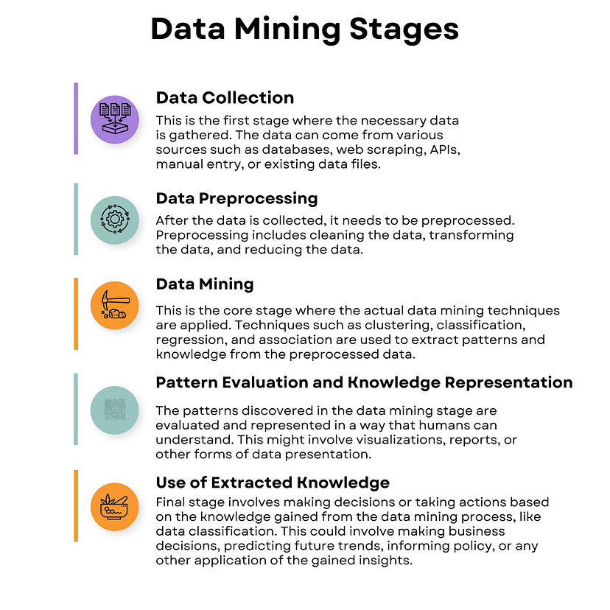

Slide 5
Data Extraction or Collection refers to gathering data from different sources, which can be structured, unstructured, or semi-structured, for processing or storage. This extracted data is used in subsequent stages.
Data Preprocessing is a technique in data mining that transforms raw, often incomplete, and inconsistent data into an understandable format. It consists of several sub-processes, including data cleaning, integration, transformation, reduction, and discretization, all aimed at resolving issues in the raw data. The critical sub-process here is data cleaning. It is the process of detecting and eliminating noise and inconsistent data from the collected dataset. This phase is critical as the quality of data significantly impacts the extraction of useful information, and it involves handling missing data, noisy data, and inconsistent data.
Data Mining is the main stage where different mathematical and computational algorithms are applied to extract patterns from the data. Techniques such as clustering, classification, regression, and association can be used.

Slide 6
Interpreting Results: Before taking any action, it’s essential to interpret and understand the results obtained from data mining. This involves analyzing patterns, trends, and relationships that have been identified in the data.
Validation and Verification: It’s important to validate the results to ensure that the insights are reliable and based on sound data. This might involve cross-validating with other data sources or using statistical methods to verify the significance of the findings.
Decision Making: With validated insights, decision-makers can make informed choices. In a business context, this could involve adjusting pricing strategies, targeting specific customer segments, or optimizing supply chains. In healthcare, it could mean adopting new treatment protocols.
Predictive Modeling: The insights gained can also be used to build predictive models that forecast future trends or outcomes. For instance, a retailer might use data mining to predict future sales trends and stock inventory accordingly.
Informing Policy: In the public sector, data mining can inform policy decisions. For example, insights from data mining can be used to shape educational policies, public health initiatives, or urban planning.

Slide 7

What is scraping?
Web scraping is the process by which data is automatically extracted from a website. This technique is used to retrieve information, such as text, images, or structured data, from a web page and transform it into a usable format.

Slide 8
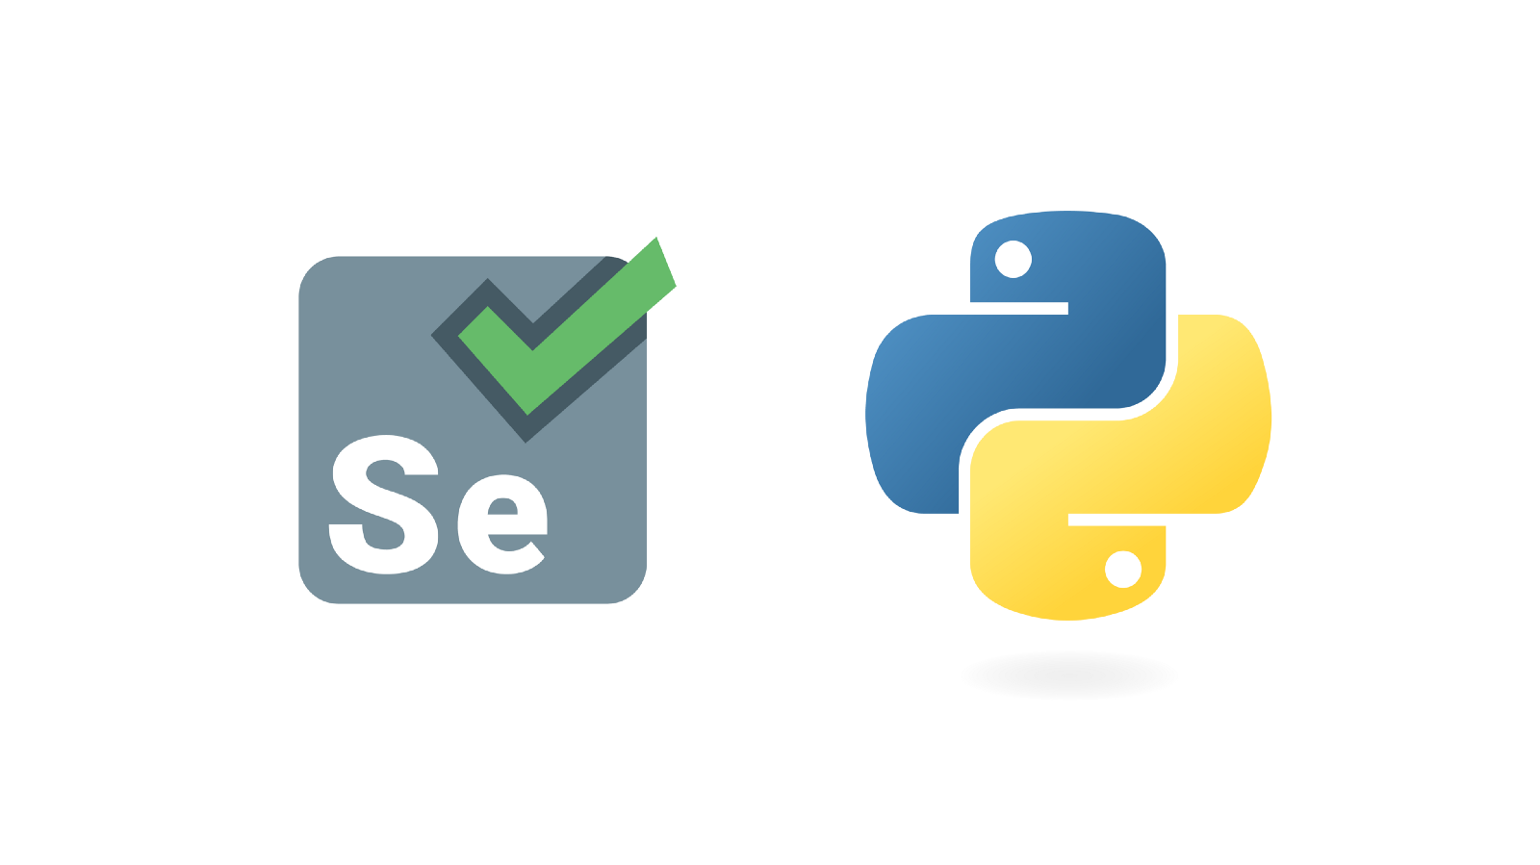

How do you scrape?
A script sends an HTTP request to the web page of interest, downloads the HTML code of the page, and then extracts the desired data.
BeautifulSoup
Selenium

Slide 9
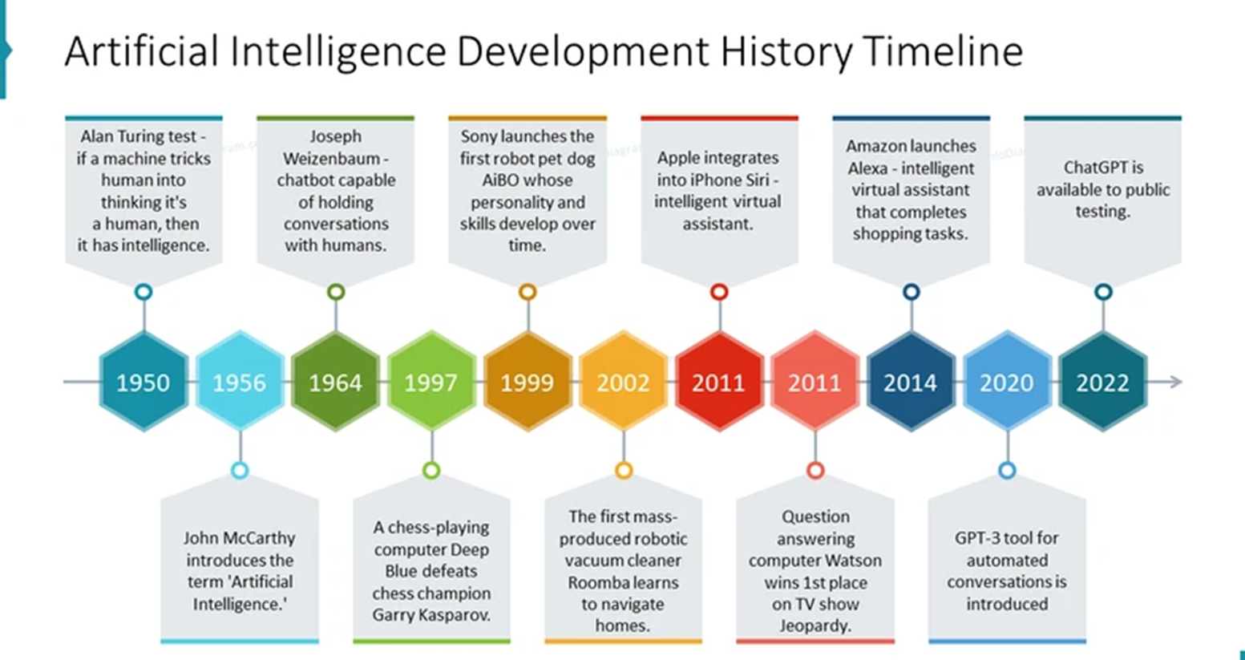
Today, artificial intelligence (AI) systems are a part of our daily lives.

Slide 10
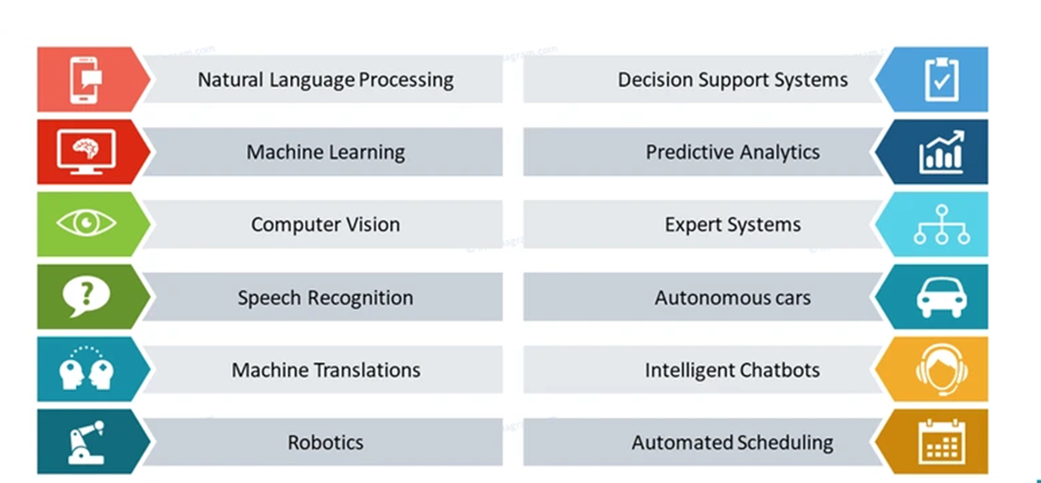
Campos de aplicación de la inteligencia artificial

Slide 11

https://github.com/Vincenzo-Miracula/L-40_DataLab

